Slide 1













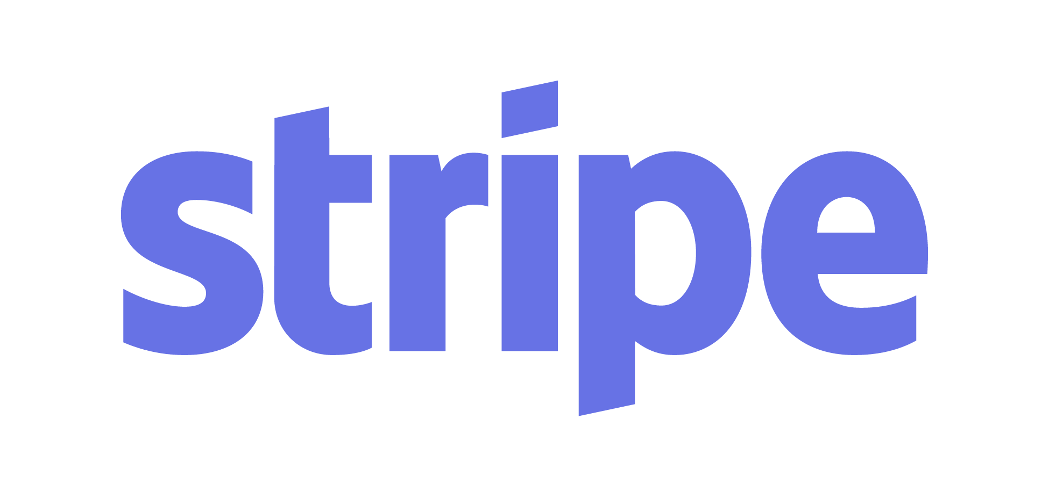
Interfaces - Removing Limits to Exponential Growth
The ‘ExO Interfaces Attribute’ is so much MORE than ‘Interfaces’!
New to the Exponential Organizations (ExO) Model? You might experience a disconnect between the classic definition of an interface, and all the power packed into this modestly-named ExO attribute.
Interface:
A point of interaction between a number of systems (i.e. people, networks, software, services).
User Interface (UI) - A person shopping on Amazon.com interacts with the Amazon systems through its User Interfaces (UI) - amazon.com, mobile apps, or through the Alexa voice assistant.
Application Programming Interface (API) - Two applications interface with each other through APIs. Google Maps Platform APIs let third-party developers provide automated custom maps and directions within their own apps and websites.
ExO Interfaces Attribute:
Interfaces connecting humans to systems (User Interface or UI), and systems to each other (Application Programming Interface or API)
All the tools and disciplines of User Experience Design (UXD)
Algorithms to filter, match, learn and curate, and automated workflows to direct the output.
Basic Application - the Interfaces Attribute is, in part, a toolkit for overcoming a host of limits to growth, creating super-scalable business processes, and connecting the other exponential attributes together.
Advanced Application - the Interfaces Attribute includes many of the building blocks for the Platform Business Models and Ecosystems at the heart of the world’s most successful ExOs.
Limits to Exponential Growth - Here’s an experiment: What happens when you give a mouse an abundance of food? What you don’t automatically get is an elephant!
So, too, for a conventional organization. It can create all the demand in the world, but if it is not designed to fulfill that fast-growing demand at 2x, 4x, 8x, 16x, 32x, 64x, it’s not an Exponential Organization.
Organizations fail to scale because of limits to growth, including:
By design, an Exponential Organization (ExO) must adequately address all relevant limits to its growth, and must continue to do so as it moves through different stages of growth.
+
≠
insufficient market size inability to generate demand inadequate business models process inefficiencies | production or quality issues unscalable cost structures labor shortages long delays to add capacity
The ExO Model
MTP
Interfaces
Staff on Demand
IDEAS
SCALE
Dashboards
Community & Crowd
Experimentation
Algorithms
Left Brain:
Order
Control
Stability
Autonomy
Leveraged
Assets
Right Brain:
Creativity
Growth
Uncertainty
Social
Engagement
Work licensed under Creative Commons Attribution-NoDerivatives 4.0 International License. By Growth Institute Inc. For a copy of this license, http://creativecommons.org/licenses/by-nd/4.0/ Rev 1.0 2019-01-20 TO LEARN HOW TO USE THIS TOOL, VISIT www.growthinstitute.com/exo

Slide 2
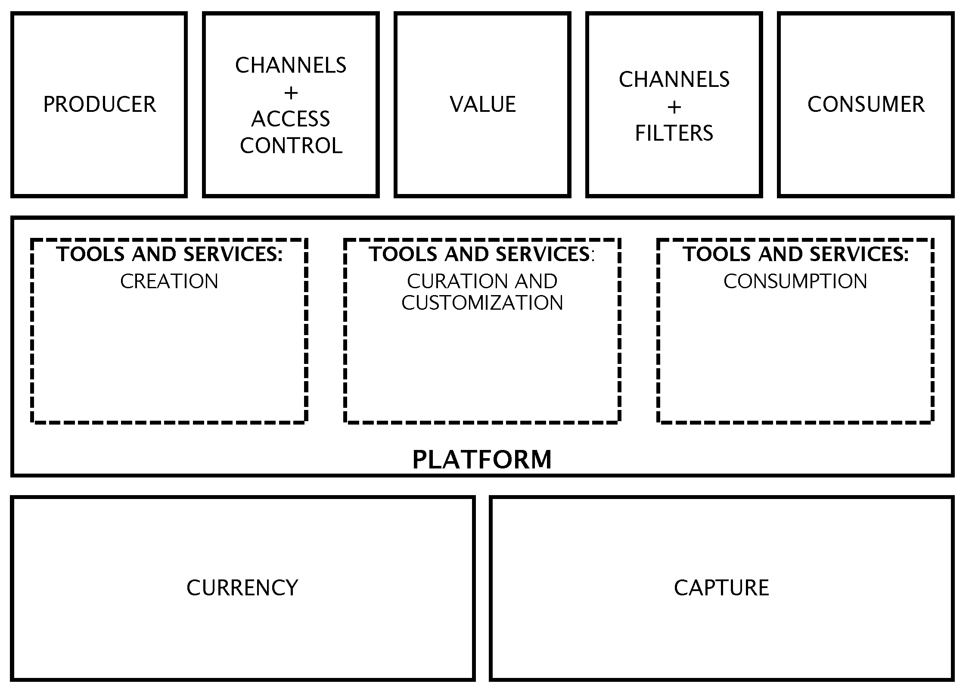
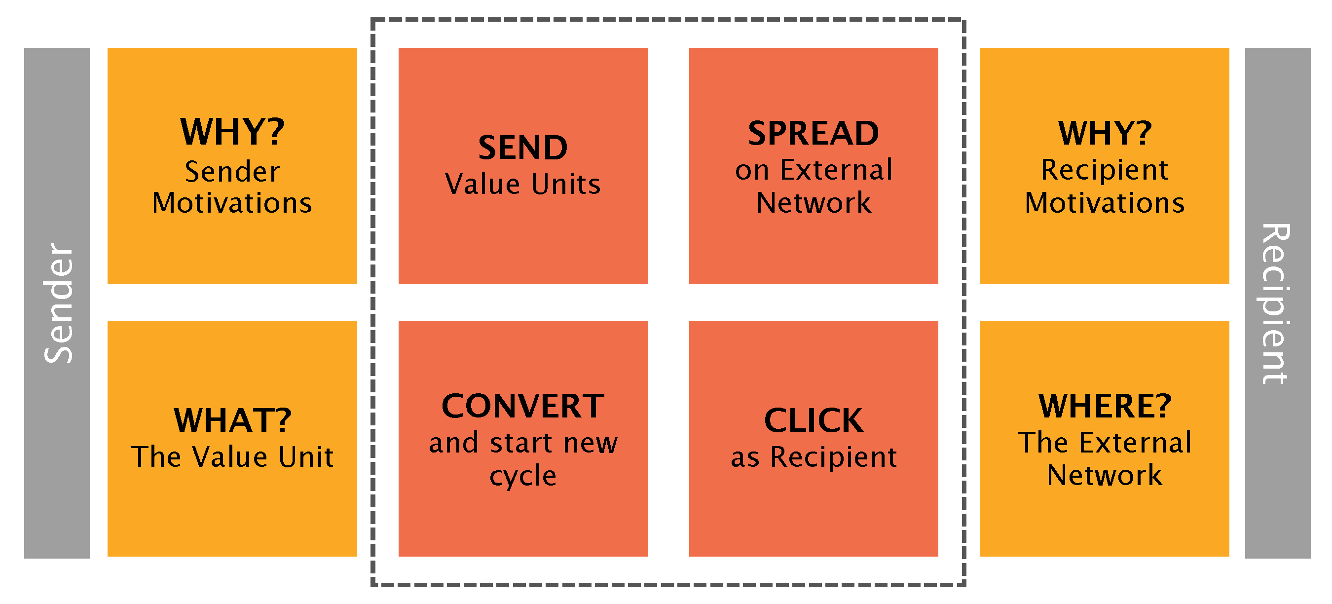
Interfaces - Identifying and Addressing Limits to Growth
Identifying Limits to Growth - A truly scalable process would keep up with exponential workload increases as it sustains quality, maintains value proposition to stakeholders, keeps bad actors out, and costs next-to-nothing to serve an additional customer or provider.
Symptoms of processes with limits to growth:
Process works manually at low volume, but breaks under load.
Each transaction is time-consuming and difficult to speed up.
Process scales, but 10x the work done requires 10x the costs.
Current process is difficult to adapt to other markets.
Reward systems encourage behavior in conflict with process goals.
Process relies on resources that are:
scarce and/or expensive
slow to put into service
prone to error
not information-enabled
Addressing Limits to Growth - Picture a company whose limit to growth is finding good people for a customer onboarding call center.
Options: Automate process with Interfaces; Algorithms; Leveraged Assets; Community and Crowd; Social Technologies.
Redesign customer-facing processes to be self-serve, and good enough that most customers neither require nor desire human support.
Replace most of the customer onboarding staff with 3rd-party AI-powered “chat-bots” on web, phone and mobile apps.
Host peer-support community site / mobile app.
Reduce owned IT infrastructure and overhead in favor of elastic capacity from Amazon Web Services etc.
Tips and Considerations
Make sure you have abundant supply and demand before you go to the trouble of building any interfaces, dashboards or workflows.
“Hand manage” the process at the beginning to deeply understand what your users want, and how the process should flow.
Ensure your user interface or API works before scaling.
Design in rapid feedback loops for your critical metrics.
Consider interfaces for staff, investors and other stakeholders.
ExOs with a platform business model must keep interactions between external consumers and producers in-balance. When experimenting with one interface, closely monitor the others. e.g. If Uber’s latest driver interface update alienates drivers, it would also undermine the rider’s experience.
Your interface may be the ONLY significant point of contact with your customers and community. Design and operate your interfaces to earn and maintain the trust of your constituents.
Resources for building platform business models
Platform Revolution - How Networked Markets Are Transforming the Economy and How to Make Them Work for You - by Geoffrey G. Parker, Marshall W. Van Alstyne and Sangeet Paul Choudary
Platform Scale - How an emerging business model helps startups build large empires with minimum investment - by Sangeet Paul Choudary
Platform Thinking Labs - Sangeet Paul Choudary’s website, where you can find the Platform Canvas Framework and the Viral Canvas Framework in the library.
Marketing Leads 500,000/wk | Sales Volume 100,000/wk | Onboarding (Call Center) 3,000/wk | Shipping Capacity 150,000/wk
The Viral Engine
THE VIRAL CANVAS
THE PLATFORM CANVAS
Work licensed under Creative Commons Attribution-NoDerivatives 4.0 International License. By Growth Institute Inc. For a copy of this license, http://creativecommons.org/licenses/by-nd/4.0/ Rev 1.0 2019-01-20 TO LEARN HOW TO USE THIS TOOL, VISIT www.growthinstitute.com/exo

Slide 3





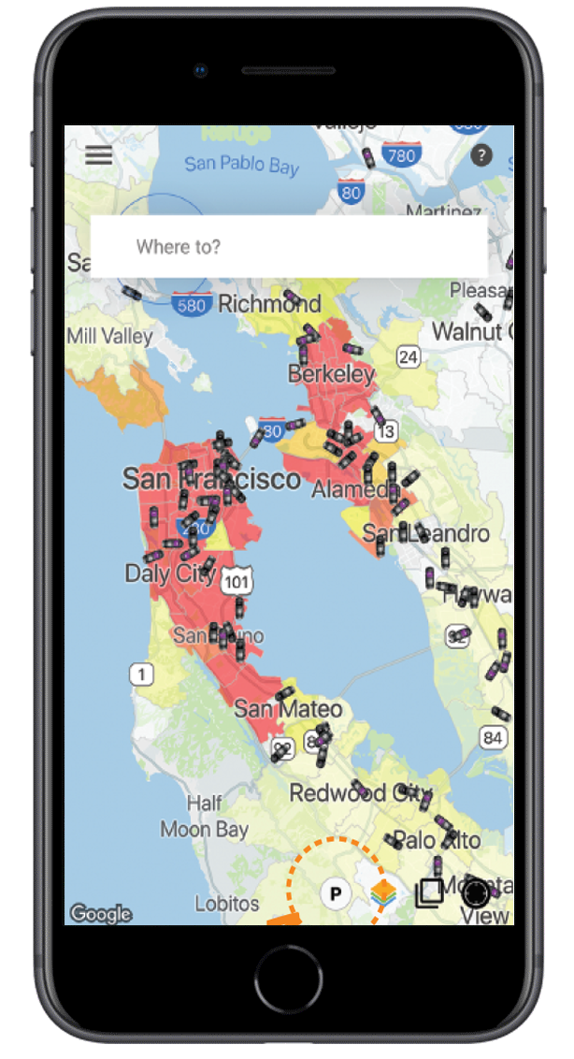

Interfaces - Application Programming
Interface (API) Case Study
APIs Power ExOs - With APIs from Google, Amazon and others, a startup can assemble the APIs into a viable business almost overnight.
Case Study: SherpaShare - Uber Drivers struggle to find enough good rides just using Uber’s Driver app, often ending up where there are too many drivers, already. SherpaShare provides a set of tools to help Uber and Lyft drivers make more income. These tools guide drivers to their next optimal pick-up area for more profitable fares. The user interface is better than Uber’s, and the algorithms are powered by millions of real-time and historical Uber pickups collected through Uber’s own Application-Programming Interface (API).*
1
2
...but the Driver can’t find enough good Riders through Uber Driver App User Interface (UI)
Rider plans ride and hails Driver through Uber Rider App User Interface (UI)
3
SherpaShare accesses Uber’s API for real-time vehicle and pickup data...
API
4
With better algorithms and UI, SherpaShare helps Drivers boost their income every shift.
Your Sherpa Says: “Turn right for
more money!”
*In July, 2018, Uber released an improved driver app incorporating many of SherpaShare’s features. From Uber’s viewpoint, its developers serve as R&D. However, if Uber repeatedly rolls up third-party features into its core services without recognition, it risks alienating its developer community. See Leveraged Assets, Community and Crowd and Platform Revolution for insight into unintended consequences, negative externalities and platform governance.
Work licensed under Creative Commons Attribution-NoDerivatives 4.0 International License. By Growth Institute Inc. For a copy of this license, http://creativecommons.org/licenses/by-nd/4.0/ Rev 1.0 2019-01-20 TO LEARN HOW TO USE THIS TOOL, VISIT www.growthinstitute.com/exo

Slide 4
Interfaces - Limits to Growth Exercise
Note: Is this your first ExO Tools worksheet? You may find it easier to first review the other attributes and accompanying ExO Tools, here.
Business Context:
What is your MTP? If you haven’t created a Massive Transformative Purpose, or to validate your existing one, download the ExO MTP Tool.
What is your core product or service?
How do you measure overall company growth, today?
Key Bottleneck to Company Growth:
List your top bottleneck or limit to exponential (10x) growth. How do you measure growth potential of this factor, now? How is it performing, currently?
What desired state or throughput or capacity do you want? Use the same metrics you defined in step 4, but think at least 10x.
How does this factor limit growth? What happens when you try to push too much work through? Why do you think that happens? (Sometimes the root cause is layers deeper than the symptom.)
Generate ExO Alternatives:
Think about the Interfaces Attribute, in combination with other ExO Attributes. List three ways you could manage or eliminate the limit(s) to growth, and achieve your MTP. As you think about potential solutions, consider if they would work at 10x throughput. Otherwise, you may find yourself designing incremental rather than exponential interventions.
If you solve this limit to growth, where will the next limit to growth appear? There is always a next limit to growth. It might show up in another internal process. It may be a constraint outside your organization i.e. insufficient supply and/or demand for your offering. In all cases, actively scan for unintended consequences of your solution, and take responsibility for ‘negative externalities’ (see Leveraged Assets).
*See Chapter 4 - Inside the Exponential Organization in Exponential Organizations by Salim Ismail, Michael S. Malone & Yuri van Geest. The Exponential Organizations Master Business Course is a part of the Growth Institute MBD Program. To learn more, visit www.growthinstitute.com/exo Share this tool - info.growthinstitute.com/interfaces-tool
Work licensed under Creative Commons Attribution-NoDerivatives 4.0 International License. By Growth Institute Inc. For a copy of this license, http://creativecommons.org/licenses/by-nd/4.0/ Rev 1.0 2019-01-20 TO LEARN HOW TO USE THIS TOOL, VISIT www.growthinstitute.com/exo

